Slide 1
Data Science
CSE-4075
(Statistics)

Slide 2
Facts are stubborn, but statistics are more pliable.
Mark Twain
Statistics refers to the mathematics and techniques with which we understand data.

Slide 3
Basic Statistical Descriptions of Data
Motivation
To better understand the data: central tendency, variation and spread
Data dispersion characteristics
median, max, min, quantiles, outliers, variance, etc.

Slide 4
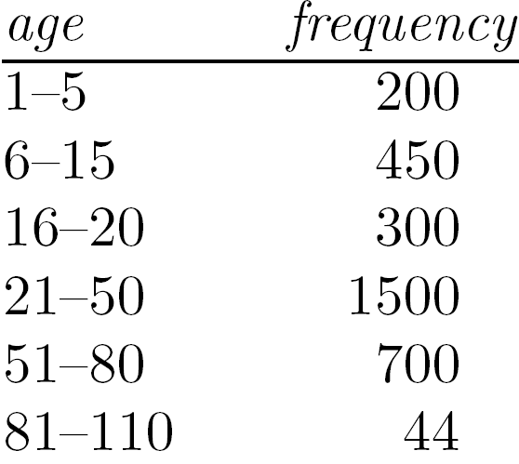
Measuring the Central Tendency
Mean (algebraic measure) (sample vs. population):
Note: n is sample size and N is population size.
Weighted arithmetic mean:
Trimmed mean: chopping extreme values
Median:
Middle value if odd number of values, or average of the middle two values otherwise
Estimated by interpolation (for grouped data):
Mode
Value that occurs most frequently in the data
Unimodal, bimodal, trimodal
Empirical formula:

Slide 5
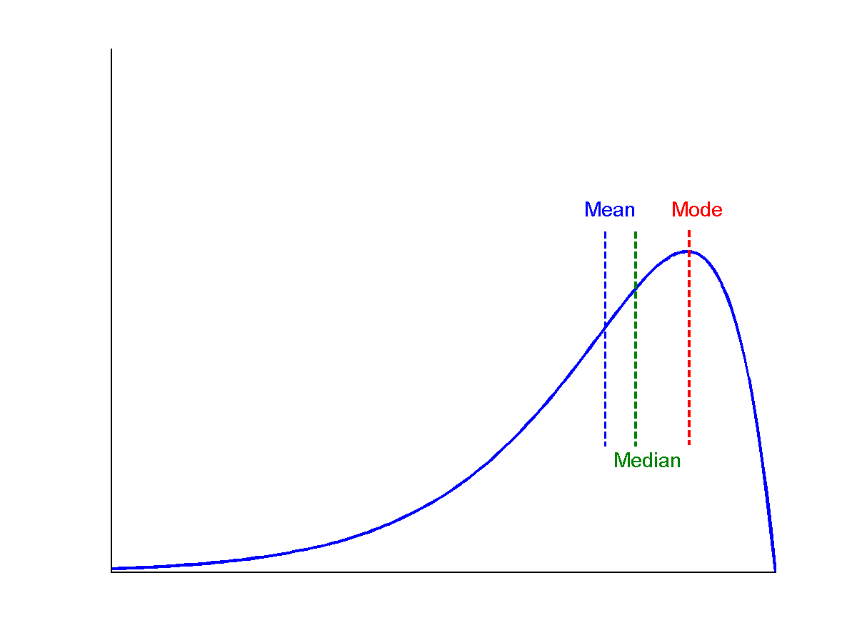
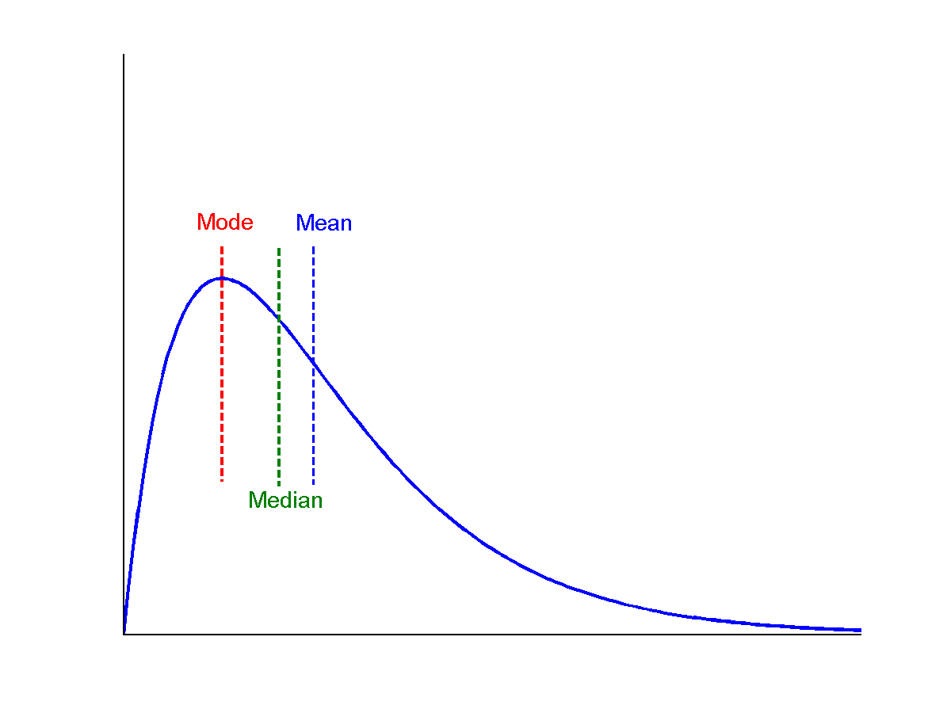
Symmetric vs. Skewed Data
Median, mean and mode of symmetric, positively and negatively skewed data
symmetric
positively skewed
negatively skewed

Slide 6
Measuring the Dispersion of Data
Quartiles, outliers and boxplots
Quartiles: Q₁ (25th percentile), Q₃ (75th percentile)
Inter-quartile range: IQR = Q₃ – Q₁
Five number summary: min, Q₁, median, Q₃, max
Boxplot: ends of the box are the quartiles; median is marked; add whiskers, and plot outliers individually
Outlier: usually, a value higher/lower than 1.5 x IQR
Variance and standard deviation (sample: s, population: σ)
Variance: (algebraic, scalable computation)
Standard deviation s (or σ) is the square root of variance s² ⁽or σ²⁾

Slide 7
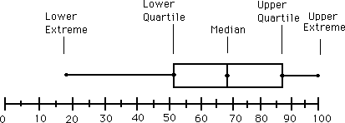
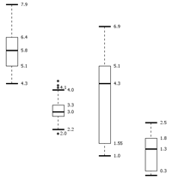
Boxplot Analysis
Five-number summary of a distribution
Minimum, Q1, Median, Q3, Maximum
Boxplot
Data is represented with a box
The ends of the box are at the first and third quartiles, i.e., the height of the box is IQR
The median is marked by a line within the box
Whiskers: two lines outside the box extended to Minimum and Maximum
Outliers: points beyond a specified outlier threshold, plotted individually

Slide 8


Slide 9
Similarity and Dissimilarity
Similarity
Numerical measure of how alike two data objects are
Value is higher when objects are more alike
Often falls in the range [0,1]
Dissimilarity (e.g., distance)
Numerical measure of how different two data objects are
Lower when objects are more alike
Minimum dissimilarity is often 0
Upper limit varies
Proximity refers to a similarity or dissimilarity

Slide 10
Data Matrix and Dissimilarity Matrix
Data matrix
n data points with p dimensions
Two modes
Dissimilarity matrix
n data points, but registers only the distance
A triangular matrix
Single mode

Slide 11
Proximity Measure for Nominal Attributes
Can take 2 or more states, e.g., red, yellow, blue, green (generalization of a binary attribute)
Method 1: Simple matching
m: # of matches, p: total # of variables
Method 2: Use a large number of binary attributes
creating a new binary attribute for each of the M nominal states

Slide 12
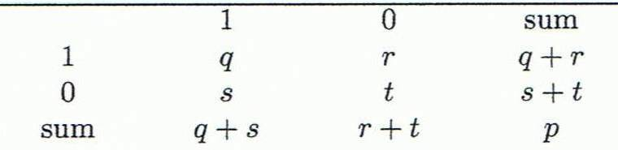
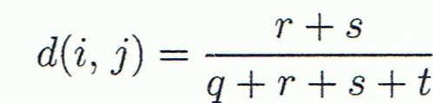
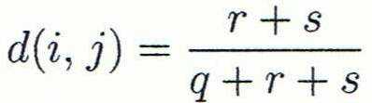

Proximity Measure for Binary Attributes
Object j
A contingency table for binary data
Distance measure for symmetric binary variables:
Distance measure for asymmetric binary variables:
Jaccard coefficient (similarity measure for asymmetric binary variables):
Object i

Slide 13
Dissimilarity between Binary Variables
Example
Gender is a symmetric attribute
The remaining attributes are asymmetric binary
Let the values Y and P be 1, and the value N 0

Slide 14
Standardizing Numeric Data
Z-score:
X: raw score to be standardized, μ: mean of the population, σ: standard deviation
the distance between the raw score and the population mean in units of the standard deviation
negative when the raw score is below the mean, “+” when above
An alternative way: Calculate the mean absolute deviation
where
standardized measure (z-score):
Using mean absolute deviation is more robust than using standard deviation

Slide 15
Example: Data Matrix and Dissimilarity Matrix
Data Matrix
Dissimilarity Matrix
(with Euclidean Distance)

Slide 16
Distance on Numeric Data: Minkowski Distance
Minkowski distance: A popular distance measure
where i = (x_{i1}, x_{i2}, …, x_{ip}) and j = (x_{j1}, x_{j2}, …, x_{jp}) are two p-dimensional data objects, and h is the order (the distance so defined is also called L-h norm)
Properties
d(i, j) > 0 if i ≠ j, and d(i, i) = 0 (Positive definiteness)
d(i, j) = d(j, i) (Symmetry)
d(i, j) ≤ d(i, k) + d(k, j) (Triangle Inequality)
A distance that satisfies these properties is a metric

Slide 17
Special Cases of Minkowski Distance
h = 1: Manhattan (city block, L₁ norm) distance
E.g., the Hamming distance: the number of bits that are different between two binary vectors
h = 2: (L₂ norm) Euclidean distance
h → ∞. “supremum” (L_{max} norm, L∞ norm) distance.
This is the maximum difference between any component (attribute) of the vectors

Slide 18
Example: Minkowski Distance
Dissimilarity Matrices
Manhattan (L₁)
Euclidean (L₂)
Supremum

Slide 19
Ordinal Variables
An ordinal variable can be discrete or continuous
Order is important, e.g., rank
Can be treated like interval-scaled
replace x_{if} by their rank
map the range of each variable onto [0, 1] by replacing i-th object in the f-th variable by
compute the dissimilarity using methods for interval-scaled variables

Slide 20
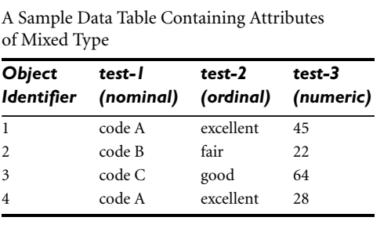
Example

Slide 21
Attributes of Mixed Type
A database may contain all attribute types
Nominal, symmetric binary, asymmetric binary, numeric, ordinal
One may use a weighted formula to combine their effects
f is binary or nominal:
d_{ij}^{(f)} = 0 if x_{if} = x_{jf} , or d_{ij}^{(f)} = 1 otherwise
f is numeric: use the normalized distance
f is ordinal
Compute ranks r_{if} and
Treat z_{if} as interval-scaled

Slide 22
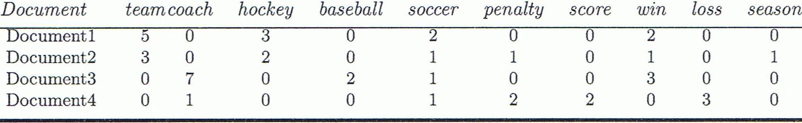
Cosine Similarity
A document can be represented by thousands of attributes, each recording the frequency of a particular word (such as keywords) or phrase in the document.
Other vector objects: gene features in micro-arrays, …
Applications: information retrieval, biologic taxonomy, gene feature mapping, ...
Cosine measure: If d₁ and d₂ are two vectors (e.g., term-frequency vectors), then
cos(d₁, d₂) = (d₁ • d₂) /||d₁|| ||d₂|| ,
where • indicates vector dot product, ||d||: the length of vector d

Slide 23
Example: Cosine Similarity
cos(d₁, d₂) = (d₁ • d₂) /||d₁|| ||d₂|| ,
where • indicates vector dot product, ||d|: the length of vector d
Ex: Find the similarity between documents 1 and 2.
d₁ = (5, 0, 3, 0, 2, 0, 0, 2, 0, 0)
d₂ = (3, 0, 2, 0, 1, 1, 0, 1, 0, 1)
d₁•d₂ = 5*3+0*0+3*2+0*0+2*1+0*1+0*1+2*1+0*0+0*1 = 25
||d₁||= (5*5+0*0+3*3+0*0+2*2+0*0+0*0+2*2+0*0+0*0)^{0.5}=(42)^{0.5} = 6.481
||d₂||= (3*3+0*0+2*2+0*0+1*1+1*1+0*0+1*1+0*0+1*1)^{0.5}=(17)^{0.5} = 4.12
cos(d₁, d₂ ) = 0.94

Slide 24
Correlation Analysis (Nominal Data)
Χ² (chi-square) test
The larger the Χ² value, the more likely the variables are related
The cells that contribute the most to the Χ² value are those whose actual count is very different from the expected count
Correlation does not imply causality
# of hospitals and # of car-theft in a city are correlated
Both are causally linked to the third variable: population

Slide 25
Chi-Square Calculation: An Example
Χ² (chi-square) calculation (numbers in parenthesis are expected counts calculated based on the data distribution in the two categories)
It shows that like_science_fiction and play_chess are correlated in the group
 | Play chess | Not play chess | Sum (row)
Like science fiction | 250(90) | 200(360) | 450
Not like science fiction | 50(210) | 1000(840) | 1050
Sum(col.) | 300 | 1200 | 1500

Slide 26
Correlation Analysis (Numeric Data)
Correlation coefficient (also called Pearson’s product moment coefficient)
where n is the number of tuples, and are the respective means of A and B, σ_{A} and σ_{B} are the respective standard deviation of A and B, and Σ(a_{i}b_{i}) is the sum of the AB cross-product.
If r_{A,B} > 0, A and B are positively correlated (A’s values increase as B’s). The higher, the stronger correlation.
r_{A,B} = 0: independent; r_{AB} < 0: negatively correlated

Slide 27
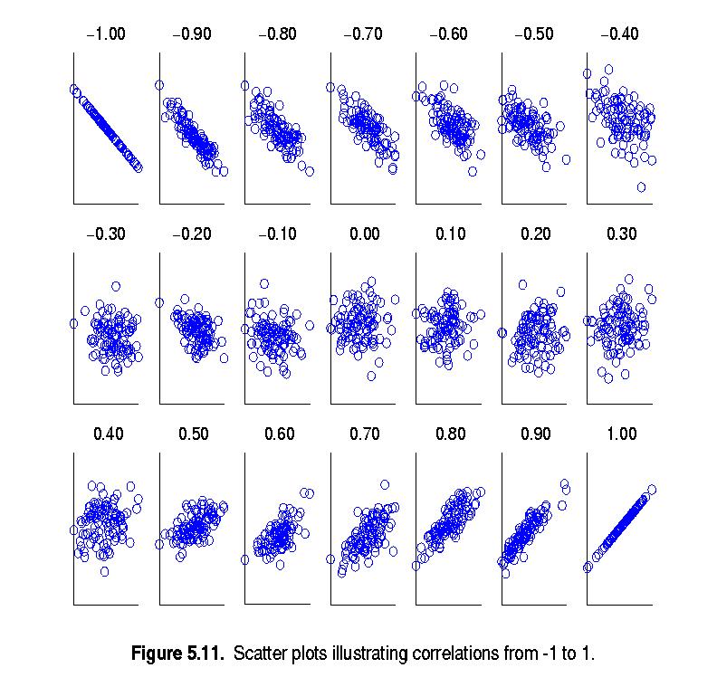
Visually Evaluating Correlation
Scatter plots showing the similarity from –1 to 1.

Slide 28
Correlation (viewed as linear relationship)
Correlation measures the linear relationship between objects
To compute correlation, we standardize data objects, A and B, and then take their dot product

Slide 29
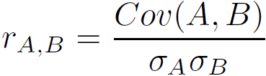
Covariance (Numeric Data)
Covariance is similar to correlation
where n is the number of tuples, and are the respective mean or expected values of A and B, σ_{A} and σ_{B} are the respective standard deviation of A and B.
Positive covariance: If Cov_{A,B} > 0, then A and B both tend to be larger than their expected values.
Negative covariance: If Cov_{A,B} < 0 then if A is larger than its expected value, B is likely to be smaller than its expected value.
Independence: Cov_{A,B} = 0 but the converse is not true:
Some pairs of random variables may have a covariance of 0 but are not independent. Only under some additional assumptions (e.g., the data follow multivariate normal distributions) does a covariance of 0 imply independence
Correlation coefficient:

Slide 30

Co-Variance: An Example
It can be simplified in computation as
Suppose two stocks A and B have the following values in one week: (2, 5), (3, 8), (5, 10), (4, 11), (6, 14).
Question: If the stocks are affected by the same industry trends, will their prices rise or fall together?
E(A) = (2 + 3 + 5 + 4 + 6)/ 5 = 20/5 = 4
E(B) = (5 + 8 + 10 + 11 + 14) /5 = 48/5 = 9.6
Cov(A,B) = (2×5+3×8+5×10+4×11+6×14)/5 − 4 × 9.6 = 4
Thus, A and B rise together since Cov(A, B) > 0.

Slide 31
Mean:
from statistics import mean
a = mean([1, 2, 4])
print(a)
2.3333333333333335
Median:
from statistics import median
a = median([1, -4, -1, -1, 1, -3])
print(a)
-1
Mode:
from statistics import mode
a =mode([1, 1, 2, 3, 3, 3, 3, 4])
print(a)
3

Slide 32
Standard deviation:
from statistics import stdev
a =stdev([1.5, 2.5, 2.5, 2.75, 3.25, 4.75])
print(a)
1.0810874155219827
Variance:
from statistics import variance
a =variance([1.5, 2.5, 2.5, 2.75, 3.25, 4.75])
print(a)
1.16875

Slide 33
Jaccard similarity :
def jaccard_similarity(x,y):
intersection_cardinality = len(set.intersection(*[set(x), set(y)]))
union_cardinality = len(set.union(*[set(x), set(y)]))
return intersection_cardinality/float(union_cardinality)
print (jaccard_similarity([0,1,2,5,6],[0,2,3,5,7,9]))
0.375

Slide 34
Euclidean distance:
from scipy.spatial import distance
a = (1,2,3)
b = (4,5,6)
dst = distance.euclidean(a,b)
print(dst)
5.19615242271
Manhattan distance :
def manhattan_distance(x,y):
return sum(abs(a-b) for a,b in zip(x,y))
print(manhattan_distance([1,2,3],[4,5,6]))
9

Slide 35
Minkowski distance:
from decimal import Decimal
def nth_root(value, n_root):
root_value = 1/float(n_root)
return round (Decimal(value) ** Decimal(root_value),3)
def minkowski_distance(x,y,p_value):
return nth_root(sum(pow(abs(a-b),p_value) for a,b in zip(x, y)),p_value)
print (minkowski_distance([1,2,3],[4,5,6],3))
4.327

Slide 36
Cosine Similarity:
from scipy import spatial
X = [3, 45, 7, 2]
Y = [2, 54, 13, 15]
result = 1 - spatial.distance.cosine(X, Y)
print (result)
0.972284251712
Chi-Square :
from scipy.stats import chi2_contingency
obs = np.array([[14452, 4073, 4287], [30864, 11439, 9887]])
chi2, p, dof, expected = chi2_contingency(obs)
print(p)
2.02258737401e-38

Slide 37
Pearson’s product moment coefficient :
import numpy as np
np.corrcoef([0.1, 0.3, 0.4, 0.8, 0.9], [3.2, 2.4, 2.4, 0.1, 5.5])[0, 1]
0.087477895607154729
Covariance:
import numpy as np
X = np.array([([0.1, 0.3, 0.4, 0.8, 0.9],
[3.2, 2.4, 2.4, 0.1, 5.5] ])
np.cov(X)[0,1]
0.057499999999999982

Slide 38
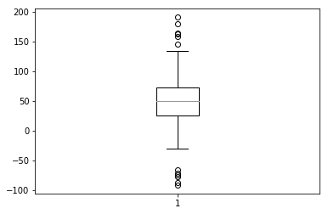
Box Plot:
import matplotlib.pyplot as plt
import numpy as np
spread = np.random.rand(50) * 100
center = np.ones(25) * 50
flier_high = np.random.rand(10) * 100 + 100
flier_low = np.random.rand(10) * -100
data = np.concatenate((spread, center, flier_high, flier_low), 0)
plt.boxplot(data)

